Slide 1
Human Computer Interaction(HCI)

Slide 2
Scope of HCI
Essentially, it is how people use and interact with technology.
Think about people physically pushing buttons or using touch screens, face recognition, or fingerprint technology.
All of these things fall into the scope of HCI.

Slide 3
Definition of HCI
It is a multidisciplinary field of study focusing on the design of computer technology and, in particular, the interaction between humans (the users) and computers.
HCI is really the place where communication between person and machine takes place, generally a display of some kind and then various other tools for sending data to and getting data from the computer.

Slide 4
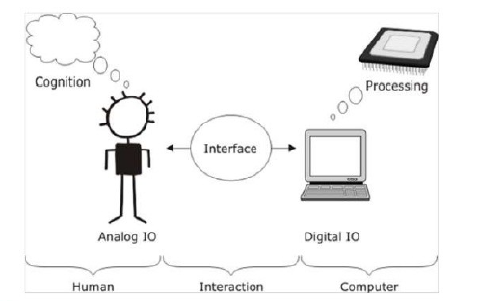
HCI

Slide 5
Human
It may mean an individual user, a group of users working together. An appreciation of the way people's sensory systems (sight, hearing, touch) relay information is vital.
Also, different users form different conceptions or mental models about their interactions and have different ways of learning and keeping knowledge and. In addition, cultural and national differences play a part.

Slide 6
Computer
When we talk about the computer, we're referring to any technology ranging from desktop computers, to large scale computer systems.
For example, if we were discussing the design of a Website, then the Website itself would be referred to as "the computer". Devices such as mobile phones or VCRs can also be considered to be ―computers.

Slide 7
Interaction
There are obvious differences between humans and machines.
In spite of these, HCI attempts to ensure that they both get on with each other and interact successfully.
In order to achieve a usable system, you need to apply what you know about humans and computers, and consult with likely users throughout the design process.
In real systems, the schedule and the budget are important, and it is vital to find a balance between what would be ideal for the users and what is feasible in reality.

Slide 8
Goal of HCI
The ultimate goal behind HCI is to design more user-friendly interfaces that make it easier for humans to navigate websites and other technologies.
That is the ultimate goal behind it. When you consider these things, you will look at how to design and assess systems accurately.
In the second part, you want to learn how to reduce your design time while you have different heuristics and interactive system design.

Slide 9
Usability
Usability is one of the key concepts in HCI. It is concerned with making systems easy to learn and use. A usable system is:
easy to learn
easy to remember how to use
effective to use
efficient to use
safe to use
enjoyable to use

Slide 10
Example of HCI
Virtual reality
As the computer and user interact, it is supposed to give the user a different perspective.
When done well, virtual reality can truly mimic the real world - a perfect example of quality HCI at work.
2) voice search, like Amazon Alexa and Google Voice Search.
These voice search applications and devices allow the user to interact with a device or system that directs them to an Amazon purchase or a Google query.
It is interesting to see how HCI has developed over the years into things that users utilize on a daily basis.

Slide 11
Evolution of HCI
Each generation of computer systems has a few vast alternates of their function and far greater benefit than the preceding generation of computer systems.
Basically, there are 5 generations of computer systems indexed under and they vary from each other in terms of architecture, occupying space, language, specification, function or operation performed, etc. Following is the list of computer generations:

Slide 12
1st Generation(1940 – 1956)
They are essentially primarily based totally on vacuum tubes, and vacuum tubes are used because of the simple components for memory and circuitry for the CPU (Central Processing Unit).
For example, UNIVAC-1 and ENIVAC.

Slide 13
2nd Generation (1957 – 1963)
This generation includes styles of gadgets transistors and magnetic core in the systems.
For example, IBM 1401, IBM 1920, etc.

Slide 14
3rd Generation (1964 – 1971)
Computer circuits changed the usage of transistors within-side the third generation of computer systems.
Integrated Circuits themselves include many transistors, capacitors, and resistors and because of this third-generation computer systems are smaller in size, efficient, and extra reliable.
For example, CDC 1700, IBM-360 Series, etc.

Slide 15
4th Generation (1972 onward)
VLSI (Very Large Scale Integrated) Circuit or they’re additionally referred to as microprocessors are utilized in this generation.
A microprocessor chip is made from hundreds of Integrated Circuits construct on a single silicon chip.
The use of Personal Computer(PCs) elevated on this generation and First Personal Computer (PC) changed into advanced through IBM.
For example, Apple, CRAY-1, etc.

Slide 16
5th Generation (Present and Future)
It is primarily based totally on Artificial intelligence (AI) software.
Artificial intelligence describes the medium and manner of creating computer systems like people, the manner human thinks, the manner people act, etc. and that is a rising department and has all of the scopes for studies work too.
For example, PARAM 10000, IBM notebooks, etc.

Slide 17
5th Generation (Present and Future)
These are incredibly dependable and use the Ultra Large Scale Integration (ULSI) technology.
The primary goal of the fifth generation is to create machines that can learn and organize themselves.
Artificial intelligence and parallel processing hardware are at the heart of this generation of computers, and artificial intelligence encompasses terms like Robotics, Neural Networks, etc.

Slide 18
Features of 5th generation
The ULSI (ultra large scale integration) technology is used in this generation of computers.
Parallel processing has advanced on these computers.
The fifth-generation computer includes more user-friendly interfaces and multimedia functions.
These PCs can be purchased for a lower price.
Computers that are more portable and powerful.
Computers are dependable and less expensive.
It’s easier to manufacture in a commercial setting.
Mainframe computers are extremely efficient.

Slide 19
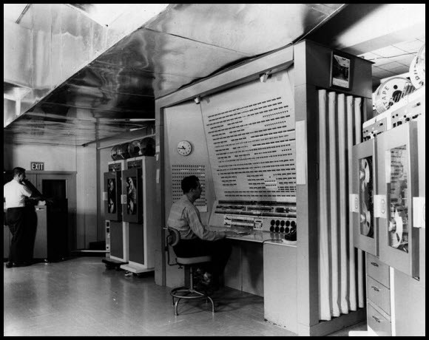
Early Human Computing interaction

